Slide 1
ENGINEERING ECONOMY
LECTURE 3
PROF.DR. YASEMİN ASU ÇIRPICI, MU, DEPT. OF ECONOMICS

Slide 2
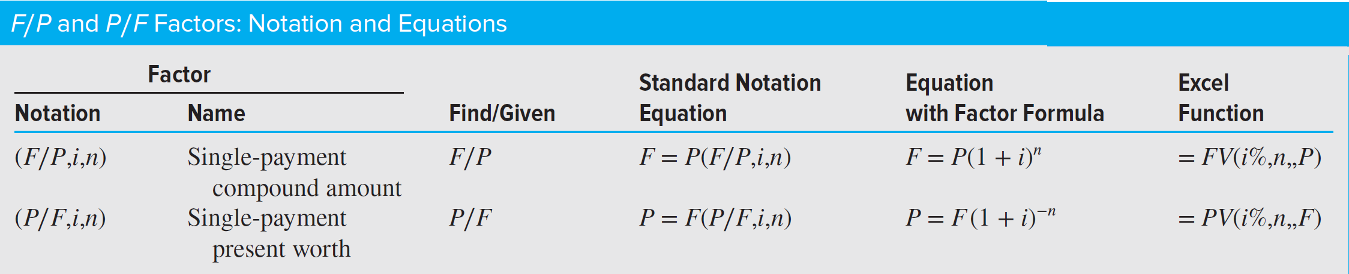

Slide 3
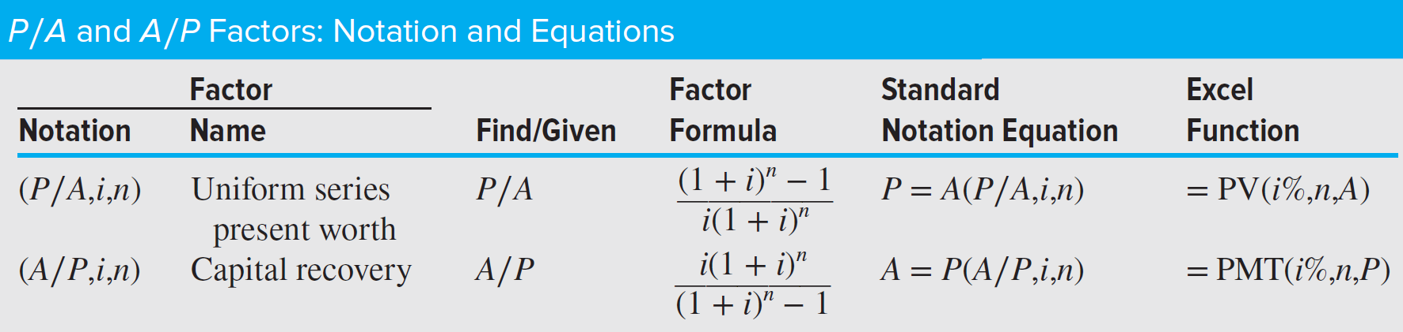
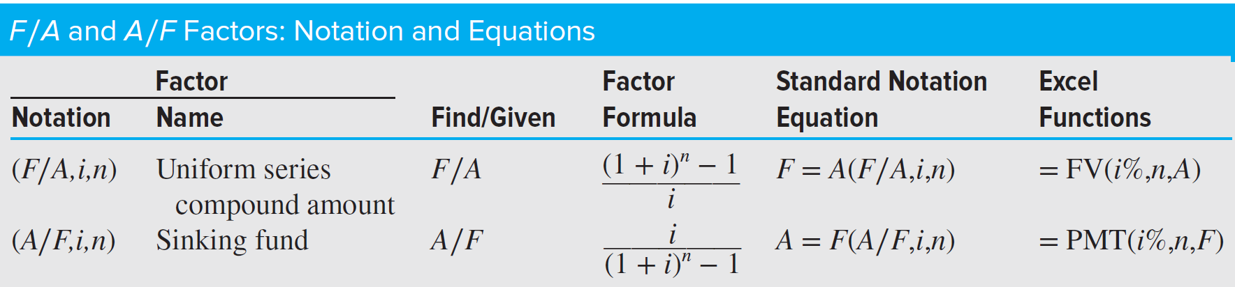

Slide 4
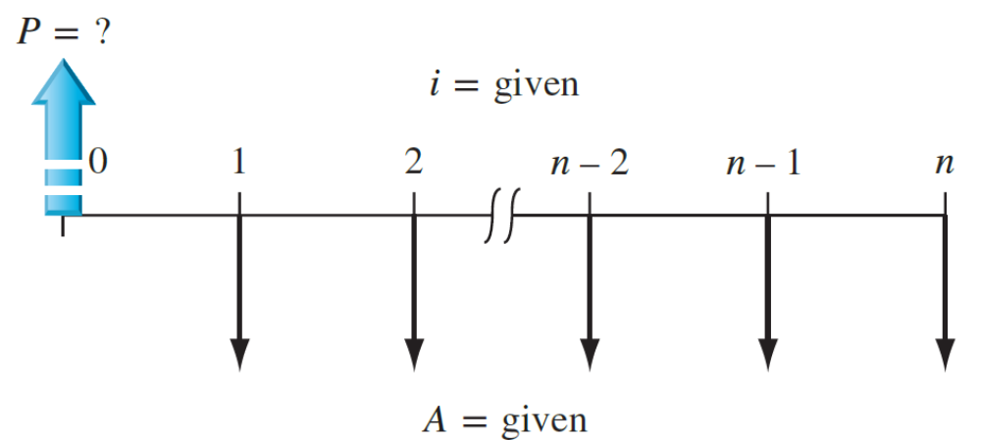
EXAMPLE
How much money should you be willing to pay now for a guaranteed $600 per year for 9 years starting next year, at a rate of return of 16% per year?
Solution
The cash flows follow the pattern of the Figure, with A = $600, i = 16%, and n = 9. The present worth is
P = 600(P∕A,16%,9) = 600(4.6065) = $2763.90

Slide 5
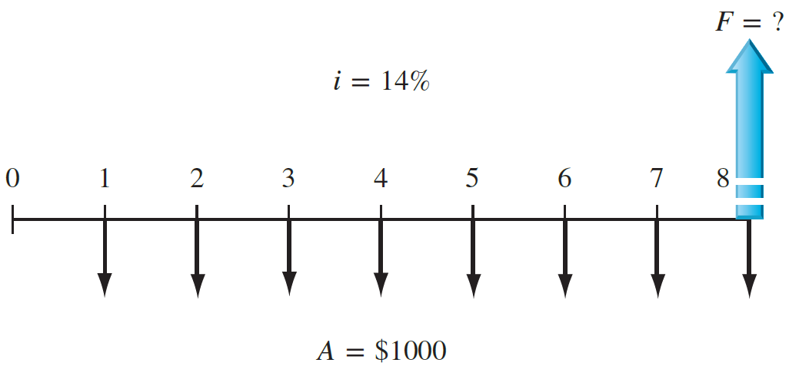
EXAMPLE
The president of Ford Motor Company wants to know the equivalent future worth of a $1 million capital investment each year for 8 years, starting 1 year from now. Ford capital earns at a rate of 14% per year.
Solution
The cash flow diagram shows the annual investments starting at the end of year 1 and ending in the year the future worth is desired. In $1000 units, the F value in year 8 is found by using the F∕A factor.
F = 1000(F∕A,14%,8) = 1000(13.2328) = $13,232.80

Slide 6
EXAMPLE
Suppose HBNA projected that $200 million investment can generate $50 million per year in revenue for 5 years starting 1 year after start-up. If 10% per year time value of money is given:
(a) What is the equivalent future worth of the estimated revenues after 5 years at 10% per year?
(b) Assume that, due to the economic downturn, the president predicts that the Corporation will earn only 4.5% per year on its money, not the previously anticipated 10% per year. What is the required amount of the annual revenue series over the 5-year period to be economically equivalent to the amount calculated in (a)?

Slide 7
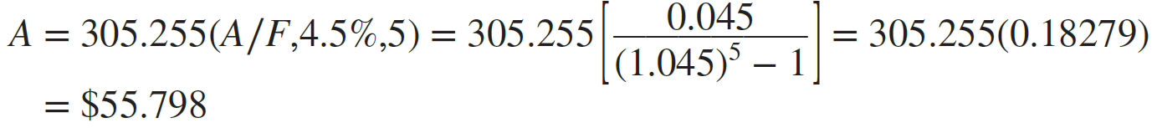
Solution
(a) Find F∕A factor. P = $200 million, A = $50 million, n = 5, i = 0.1
F = 50(F∕A,10%,5) = 50(6.1051)
= $305.255
(b) The A∕F factor will determine the required A for 5 years. i = 0.045

Slide 8
Arithmetic Gradient Factors (P∕G and A∕G)
An arithmetic gradient is a cash flow that either increases or decreases by a constant amount.
The cash flow, changes by the same amount each period.
The amount of decrease or the increase is the gradient or G.
Therefore, it is composed of base amount and gradient part.

Slide 9
Formulas previously developed for an A series have year-end amounts of equal value.
In the case of a gradient, each year-end cash flow is different, so new formulas must be derived.
First, assume that the cash flow at the end of year 1 is the base amount of the cash flow series and, therefore, not part of the gradient series.
This is convenient because in actual applications, the base amount is usually significantly different in size compared to the gradient.
For example, if you purchase a used car with a 1-year warranty, you might expect to pay the gasoline and insurance costs during the first year of operation.
Assume these cost $2500; that is, $2500 is the base amount.
After the first year, you absorb the cost of repairs, which can be expected to increase each year.

Slide 10
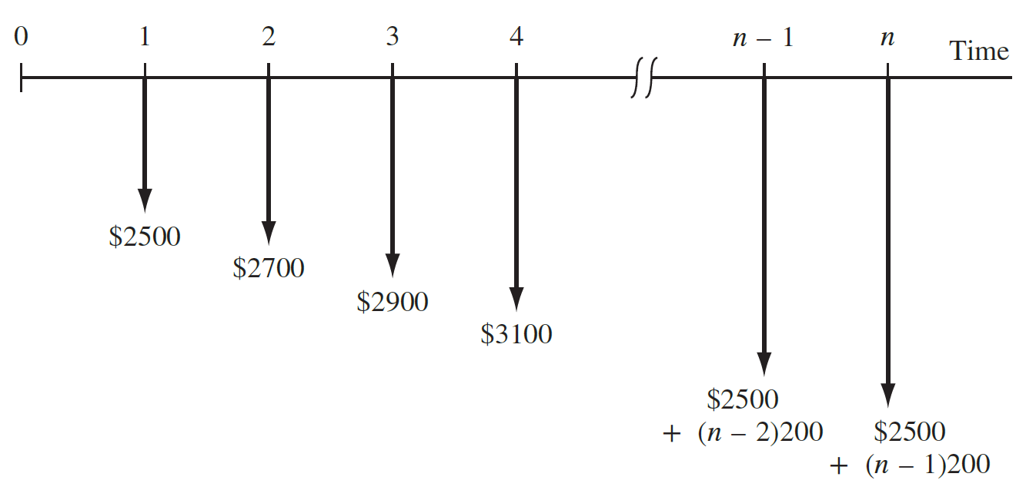
If you estimate that total costs will increase by $200 each year, the amount the second year is $2700, the third $2900, and so on to year n, when the total cost is 2500 + (n − 1)200.
The cash flow diagram is shown in the Figure.
Note that the gradient ($200) is first observed between year 1 and year 2, and the base amount ($2500 in year 1) is not equal to the gradient.

Slide 11

Define the symbols G for gradient and CFn for cash flow in year n as follows:
G = constant arithmetic change in cash flows from one time period to the next; G may be positive or negative.
It is important to realize that the base amount defines a uniform cash flow series of the size A that occurs each time period.
We will use this fact when calculating equivalent amounts that involve arithmetic gradients.

Slide 12
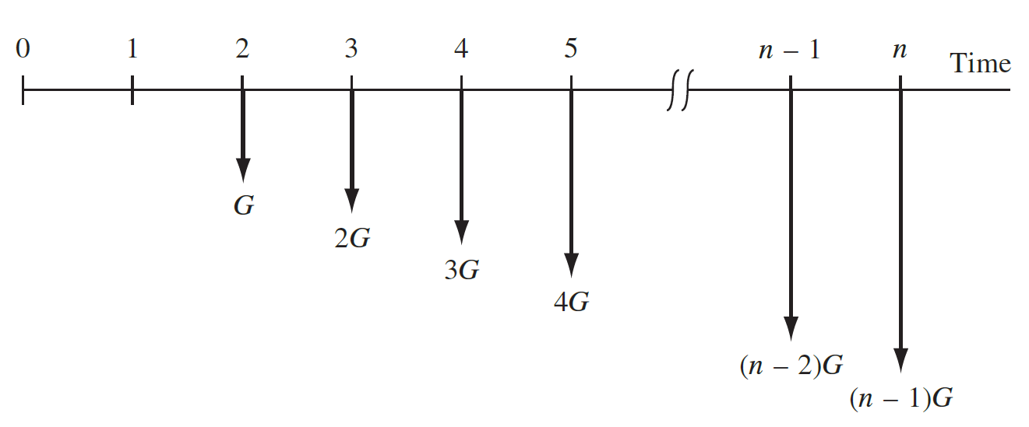
If the base amount is ignored, a generalized arithmetic (increasing) gradient cash flow diagram is as shown as:
Note that the gradient begins between years 1 and 2. This is called a conventional gradient.

Slide 13
EXAMPLE
A local university has initiated a logo-licensing program with the clothier Holister, Inc. Estimated fees (revenues) are $80,000 for the first year with uniform increases to a total of $200,000 by the end of year 9.
Determine the gradient and construct a cash flow diagram that identifies the base amount and the gradient series.

Slide 14
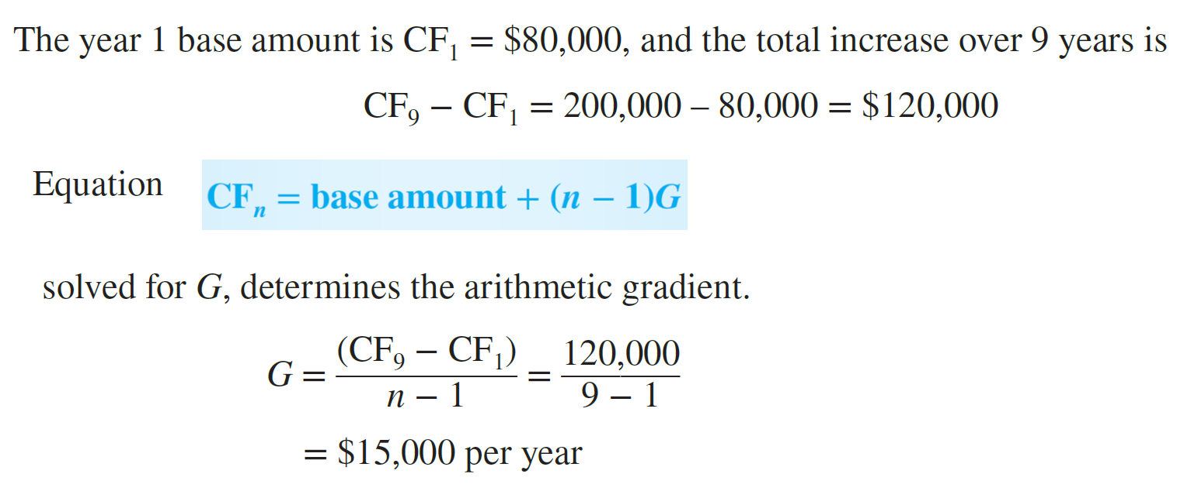

Slide 15
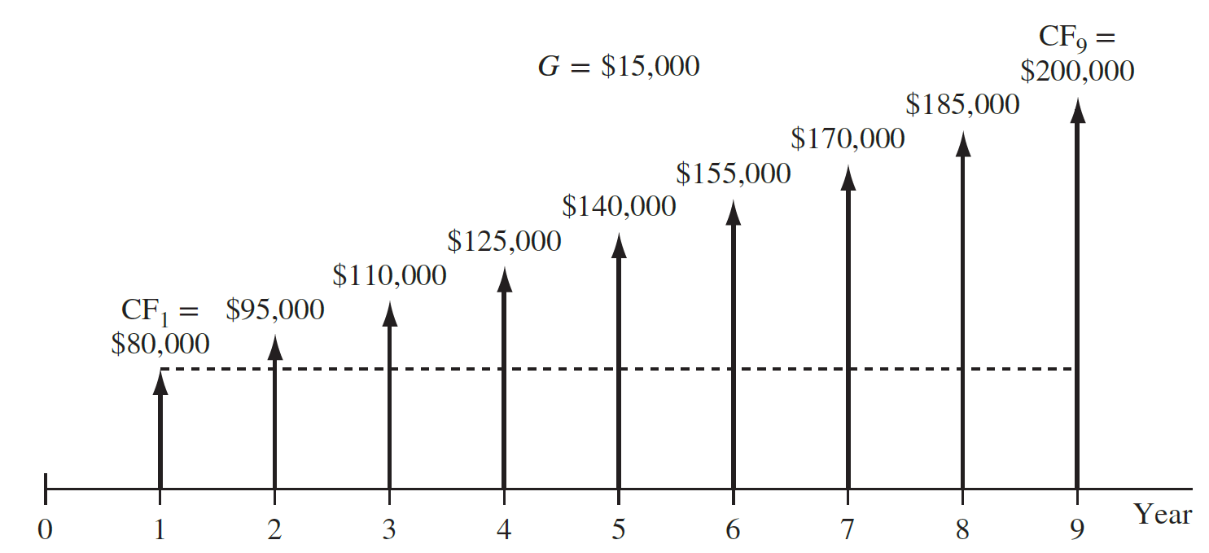
The cash flow diagram shows the base amount of $80,000 in years 1 through 9 and the $15,000 gradient starting in year 2 and continuing through year 9.

Slide 16
The total present worth PT for a series that includes a base amount A and conventional arithmetic gradient must consider the present worth of both the uniform series defined by A and the arithmetic gradient series. The addition of the two results in P_{T} .
P_{T} = P_{A} ± P_{G}
where P_{A} is the present worth of the uniform series only, P_{G} is the present worth of the gradient series only, and the + or − sign is used for an increasing (+G) or decreasing (−G) gradient, respectively.
The corresponding equivalent annual worth A_{T} is the sum of the base amount series annual worth A_{A} and gradient series annual worth A_{G}, that is,
A_{T} = A_{A} ± A_{G}
Three factors are derived for arithmetic gradients: the P∕G factor for present worth, the A∕G factor for annual series, and the F∕G factor for future worth. There are several ways to derive them. We use the single-payment present worth factor (P∕F,i,n), but the same result can be obtained by using the F∕P, F∕A, or P∕A factor.

Slide 17
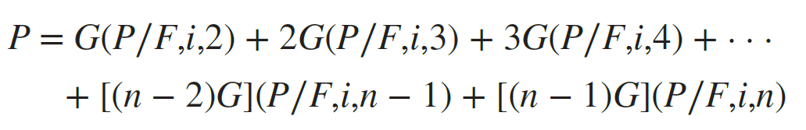
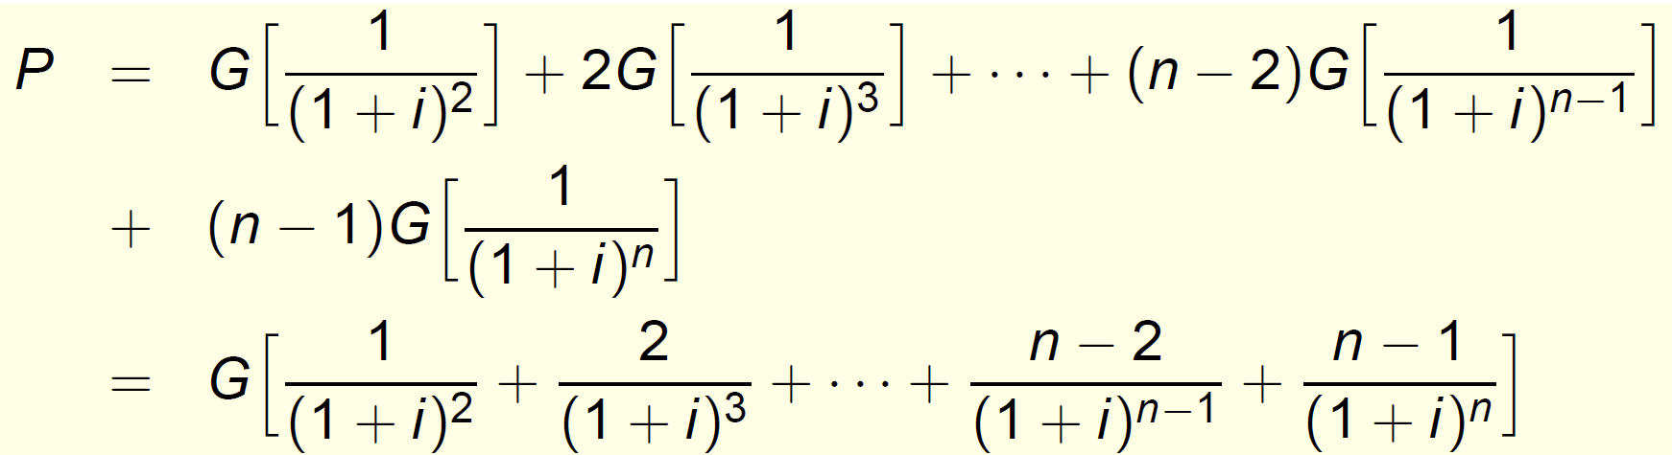

Slide 18
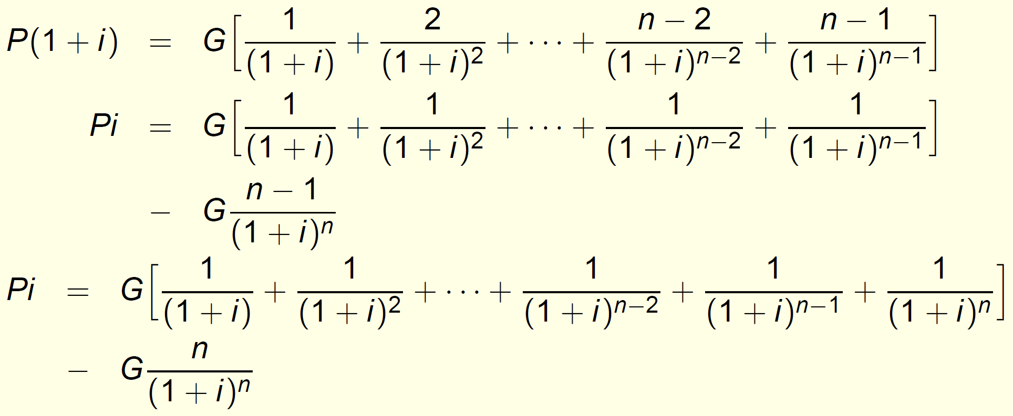
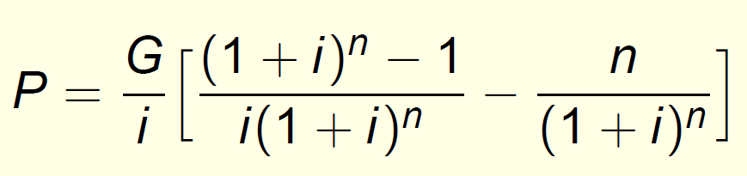

Slide 19
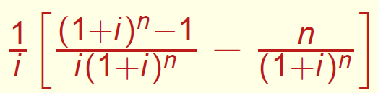
is the arithmetic-gradient present worth factor or P/G factor that converts the arithmetic gradient (without base amount) for n years to the present worth at year 0. The standard notation is (P/G, i%, n).
The equivalent uniform annual series A for an arithmetic gradient G is found by multiplying (P/G, i%, n) by (A/P,i%,n)
A = G(P/G, i%, n)(A/P, i%, n)
= G(A/G, i%, n)

Slide 20
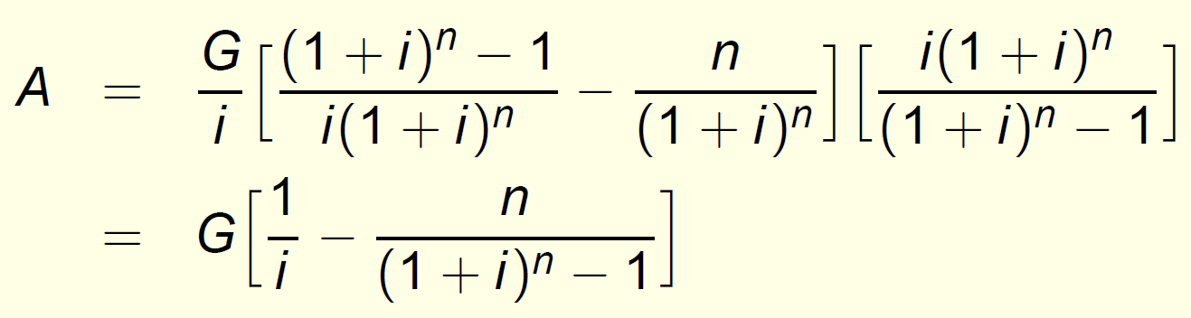
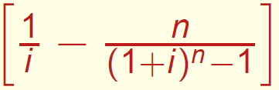
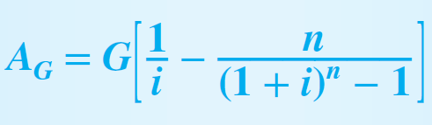
is the arithmetic-gradient uniform-series factor and is identified by (A/G, i%, n).

Slide 21
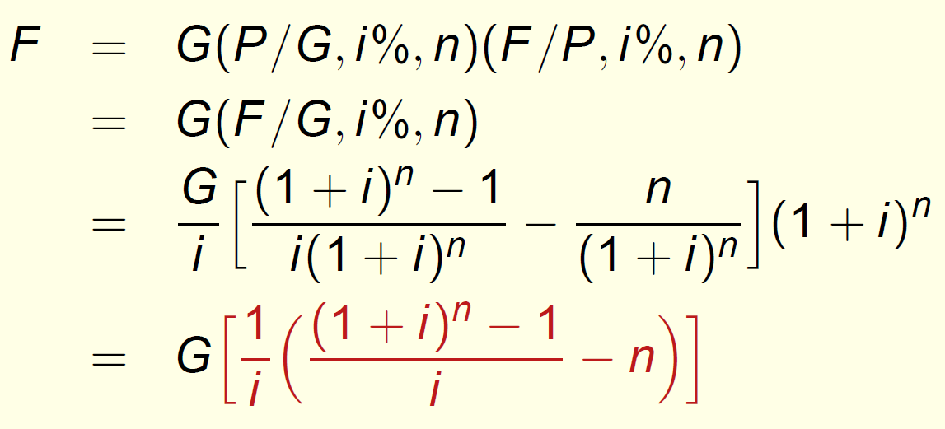
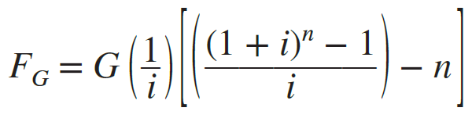
An F/G factor (arithmetic-gradient future worth factor)can be found by multiplying P/G and F/P factors. The resulting (F/G, i%, n) is:

Slide 22
The total present worth P_{T} of a gradient series must consider the base and the gradient separately.
Let P_{A} be the present worth of the base amount; uniform series amount A starting from the end of period 1 extending through period n.
Let P_{G} be the present worth of an increasing gradient and −P_{G} be the present worth of an decreasing gradient.
Therefore: P_{T} = P_{A} + P_{G} and P_{T} = P_{A} − P_{G} for increasing and decreasing gradient series, respectively.

Slide 23
EXAMPLE
Three counties in Florida agreed to pool tax resources already designated for county-maintained bridge refurbishment. At a recent meeting, the county engineers estimated that a total of $500,000 will be deposited at the end of next year into an account for the repair of old bridges throughout the three-county area.
Further, they estimate the deposits will increase by $100,000 per year for only 9 years thereafter, then cease.
Determine the equivalent (a) present worth, and (b) annual series amounts, if public funds earn at a rate of 5% per year.

Slide 24
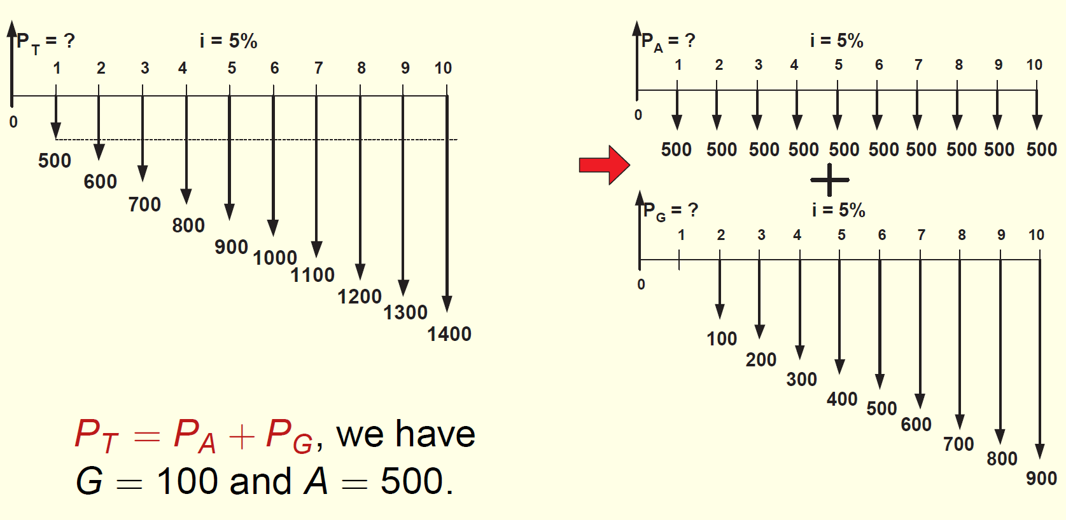

Slide 25
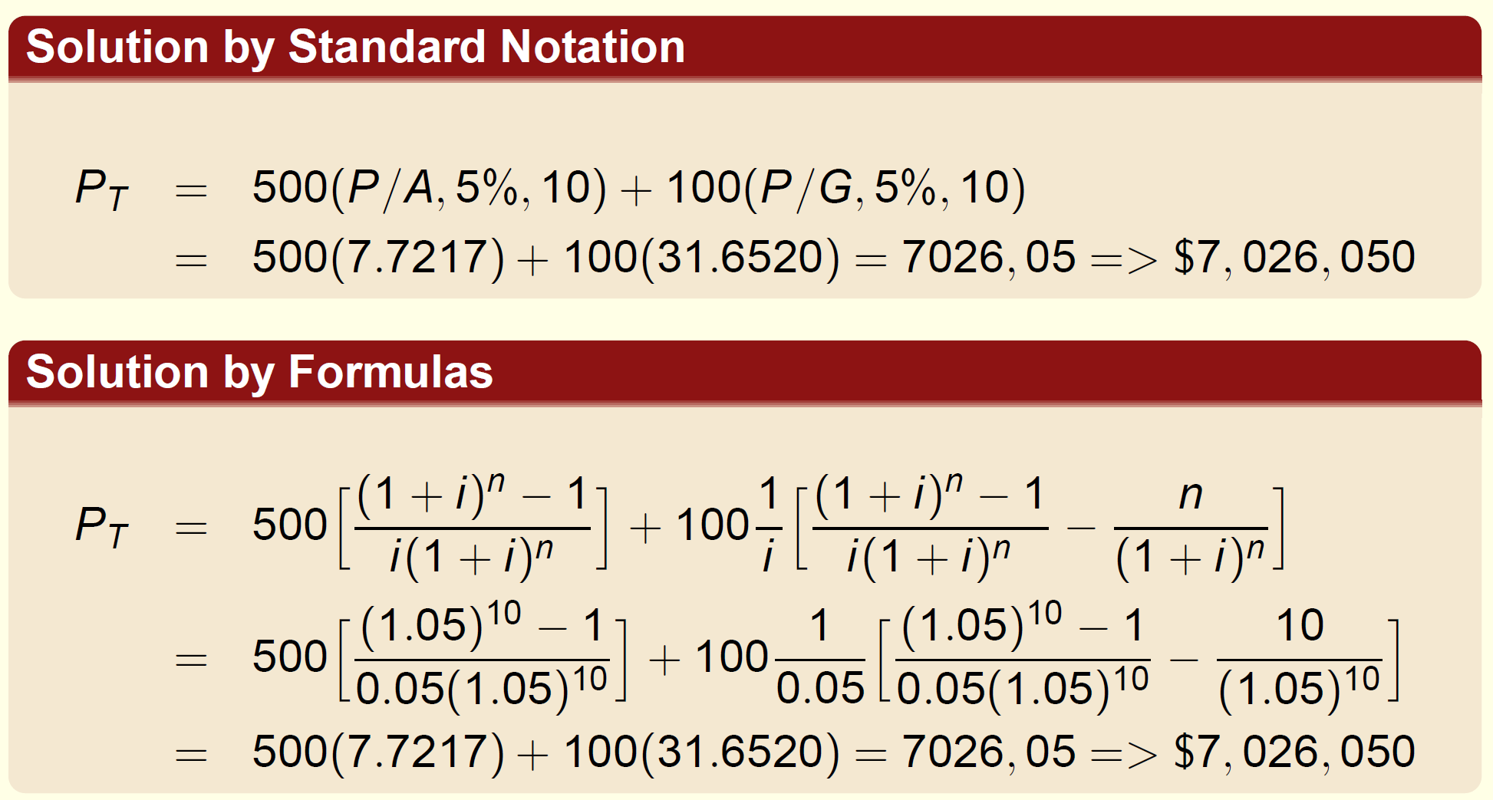

Slide 26
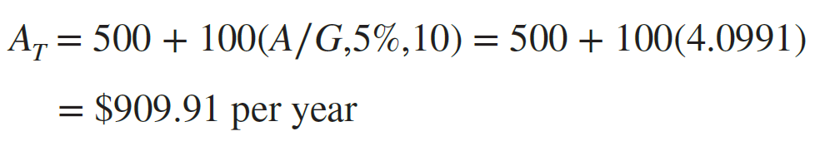
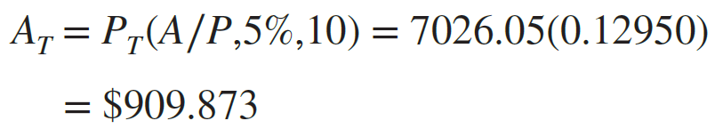
(b) consider the gradient and the base amount separately.
The total annual series A_{T} (occuring in years 1 through 10. ) is found by
Comment
Remember: The P∕G and A∕G factors determine the present worth and annual series of the gradient only.
Any other cash flows must be considered separately.
If the present worth is already calculated [as in part (a)], PT can be multiplied by an A∕P factor to get AT. In this case, considering round-off error,

Slide 27
EXAMPLE
The announcement of the HBNA steel plant states that the $200 million (M) investment is planned for 2020. Most large investment commitments are actually spread out over several years as the plant is constructed and production is initiated. Further investigation may determine, for example, that the $200 M is a present worth in the year 2020 of anticipated investments during the next 4 years (2021 through 2024). Assume the amount planned for 2021 is $100 M with constant decreases of $25 M each year thereafter. Assume the time value of money for investment capital is 10% per year to answer the following questions
(a) In equivalent present worth values, does the planned decreasing investment series equal the announced $200 M in 2020? Use both tabulated factors and spreadsheet functions.
(b) Given the planned investment series, what is the equivalent annual amount that will be invested from 2021 to 2024?

Slide 28
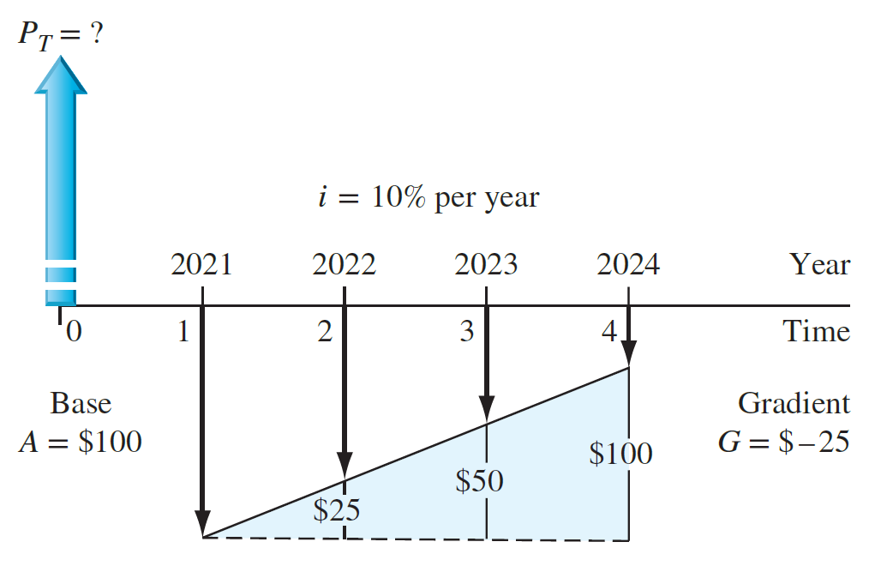
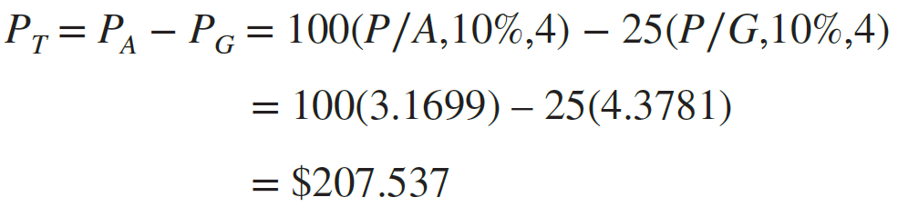
(a) The investment series is a decreasing arithmetic gradient with a base amount of $100 M in year 1 (2021) and G = $−25 M through year 4 (2024).
Shaded area shows the constantly declining investment each year
In present worth terms, the planned series will exceed the equivalent of $200 M in 2020 by approximately $7.5 M.

Slide 29


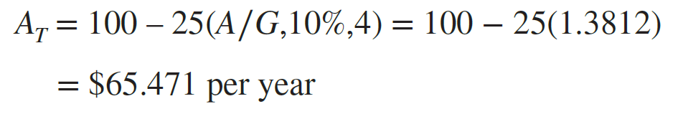

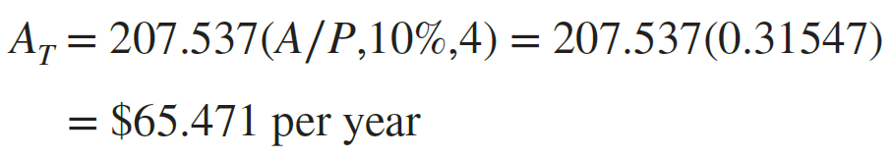
(b) There are two equally correct ways to find A_{T}.

Slide 30
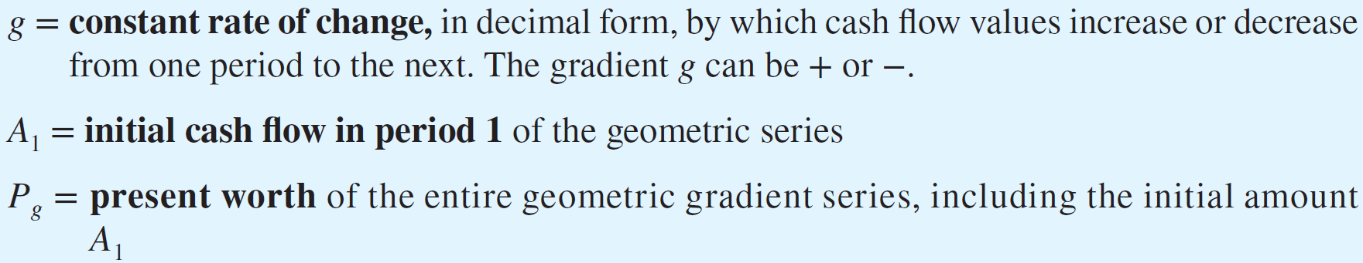
Geometric Gradient Series Factors
Cash flow series that increase or decrease from period to period by constant percentage.
g is the constant rate of change in decimal form, by which amounts change
The series starts at the end of year 1, with amount A1, which is not considered as a base amount

Slide 31
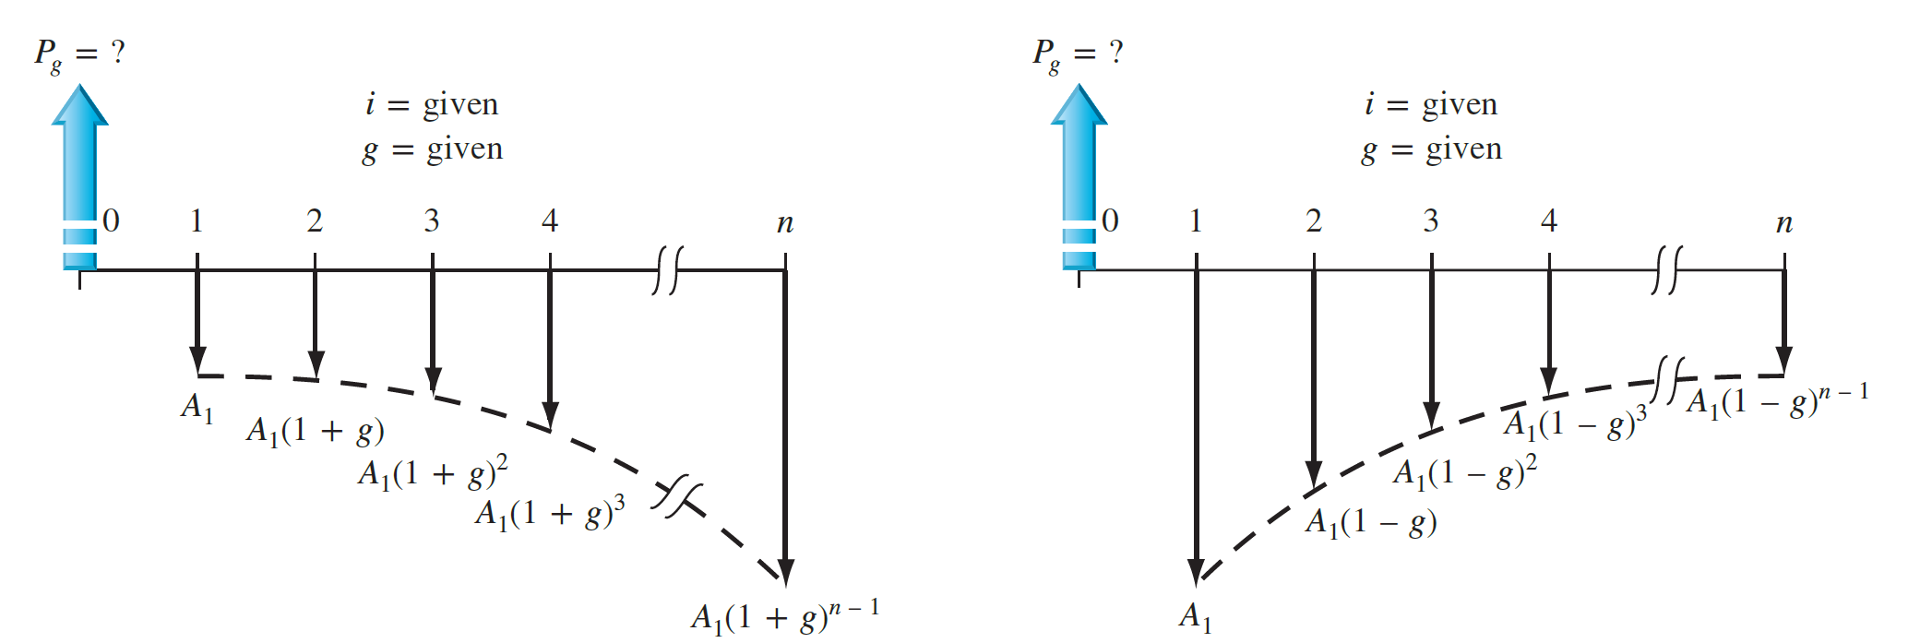
Note that the initial cash flow A₁ is not considered separately when working with geometric gradients.
Figure shows increasing and decreasing geometric gradients starting at an amount A₁ in time period 1 with present worth Pg located at time 0.

Slide 32
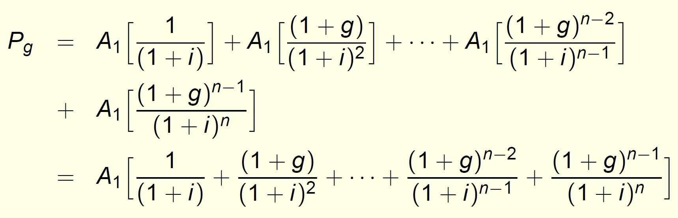
The total present worth Pg for the entire cash flow series can be derived as:

Slide 33
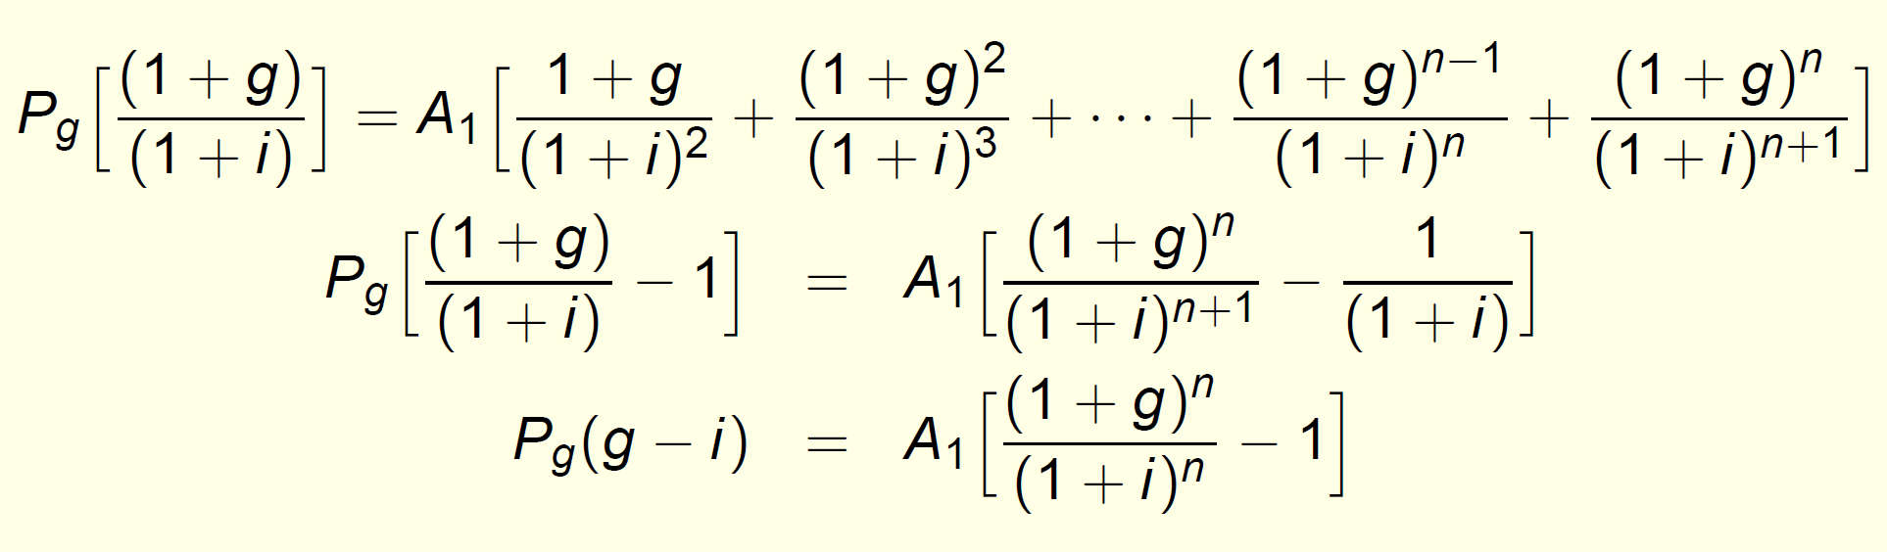

Slide 34
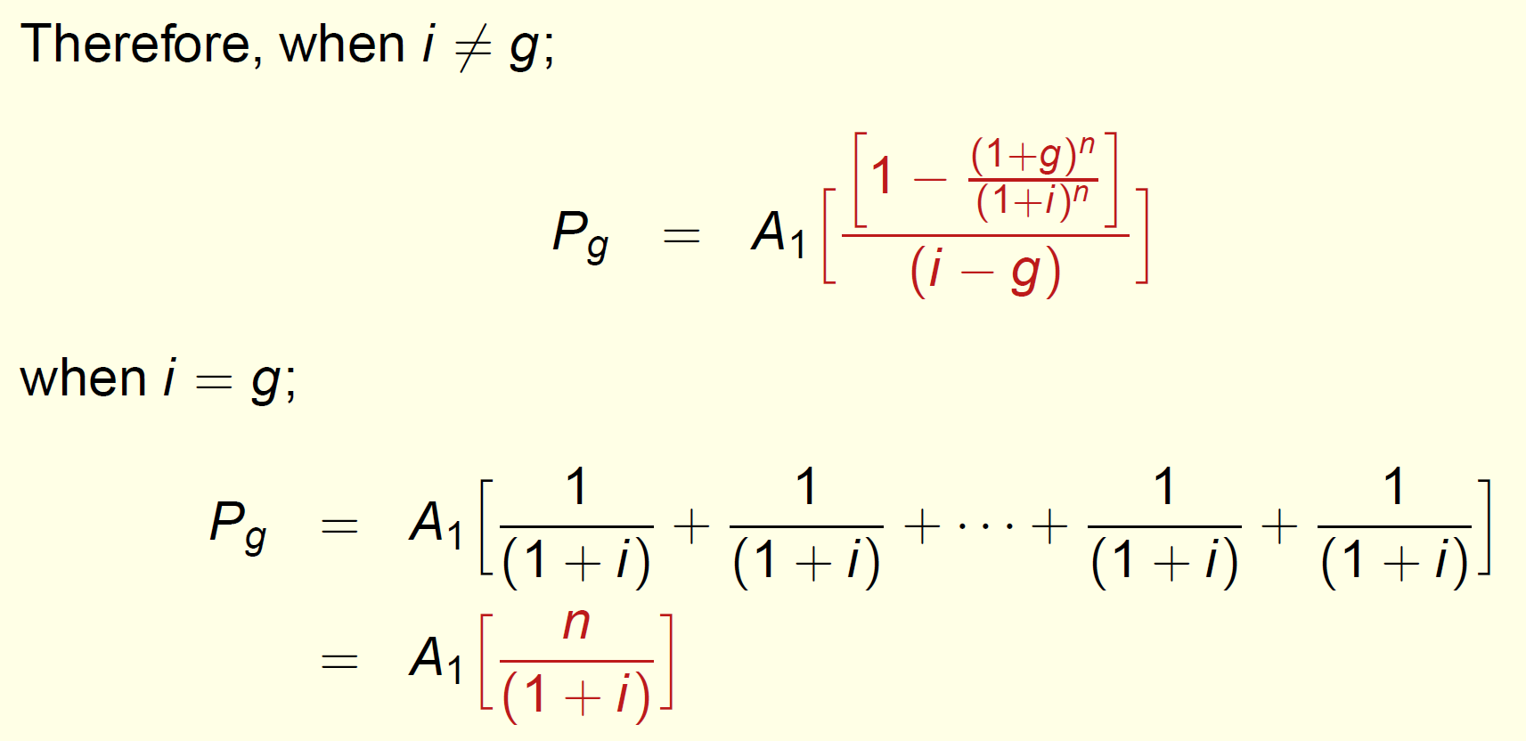
These two factors, depending on the case whether g = i or not, will transform the geometric-gradient series starting at the end of period 1 with amount A1 that is changing with constant rate g to the the present worth Pg at time 0. The standard notation for the factor is (P/A, g, i, n).

Slide 35
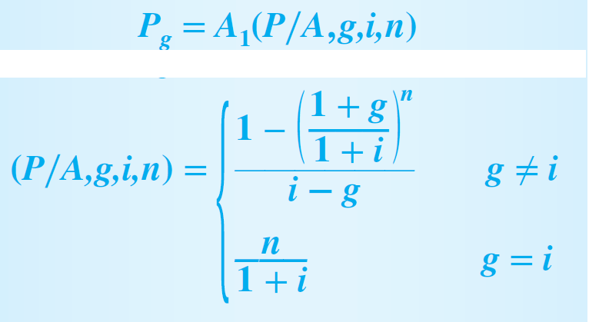
These two factors, depending on the case whether g = i or not, will transform the geometric-gradient series starting at the end of period 1 with amount A1 that is changing with constant rate g to the the present worth Pg at time 0. The standard notation for the factor is (P/A, g, i, n).
It is possible to derive factors for the equivalent A and F values; however, it is easier to determine the Pg amount and then multiply by the A∕P or F∕P factor.

Slide 36
EXAMPLE
A coal-fired power plant has upgraded an emission control valve. The modification costs only $8000 and is expected to last 6 years with a $200 salvage value.
The maintenance cost is expected to be high at $1700 the first year, increasing by 11% per year thereafter.
Determine the equivalent present worth of the modification and maintenance cost at 8% per year.
Notes:
Salvage: kurtarma

Slide 37
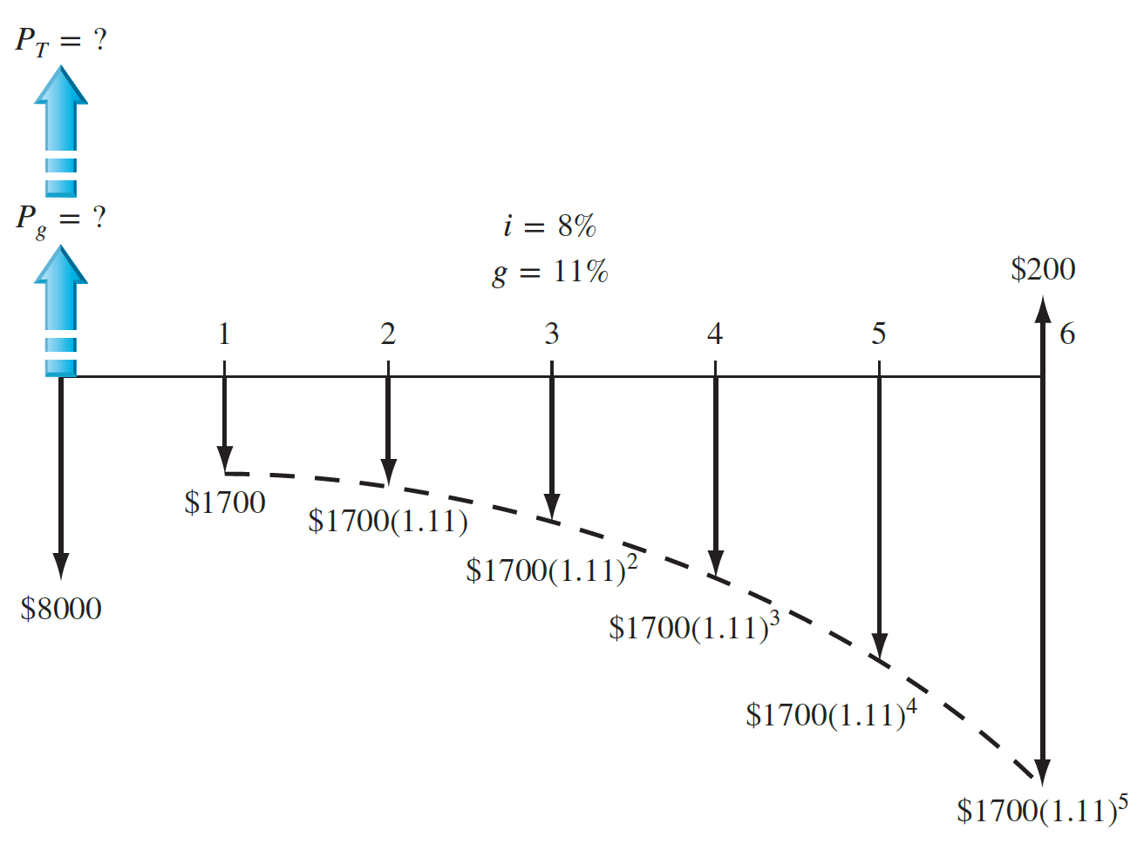
The cash flow diagram shows the salvage value as a positive cash flow and all costs as negative.

Slide 38
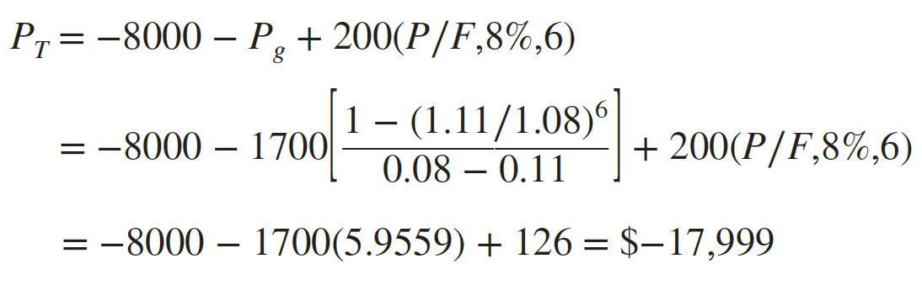
For g ≠ i to calculate Pg. Total P_{T} is the sum of three present worth components.

Slide 39
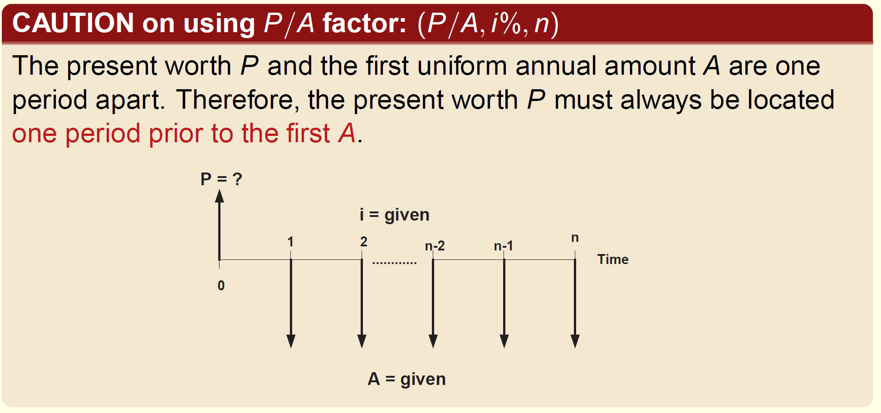

Slide 40
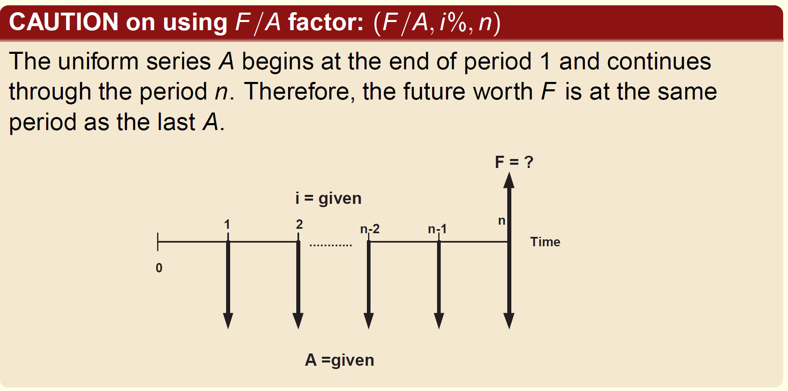

Slide 41
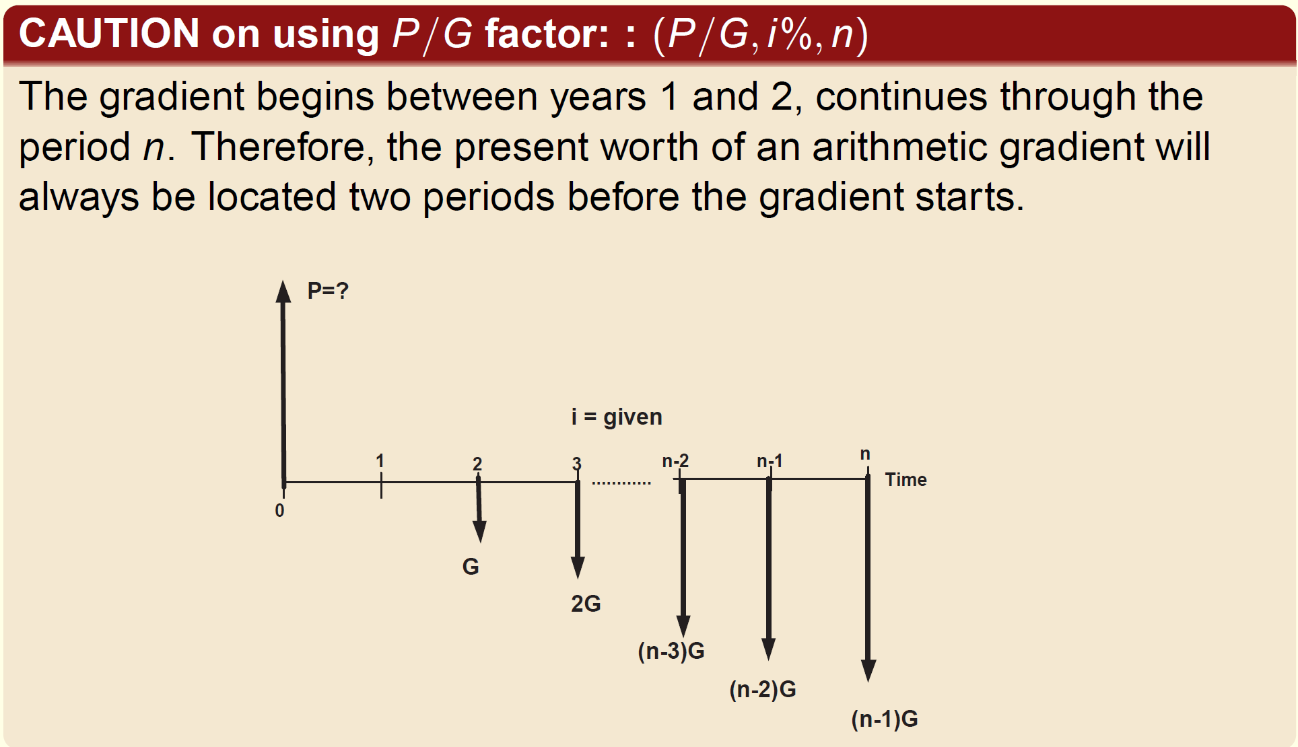

Slide 42
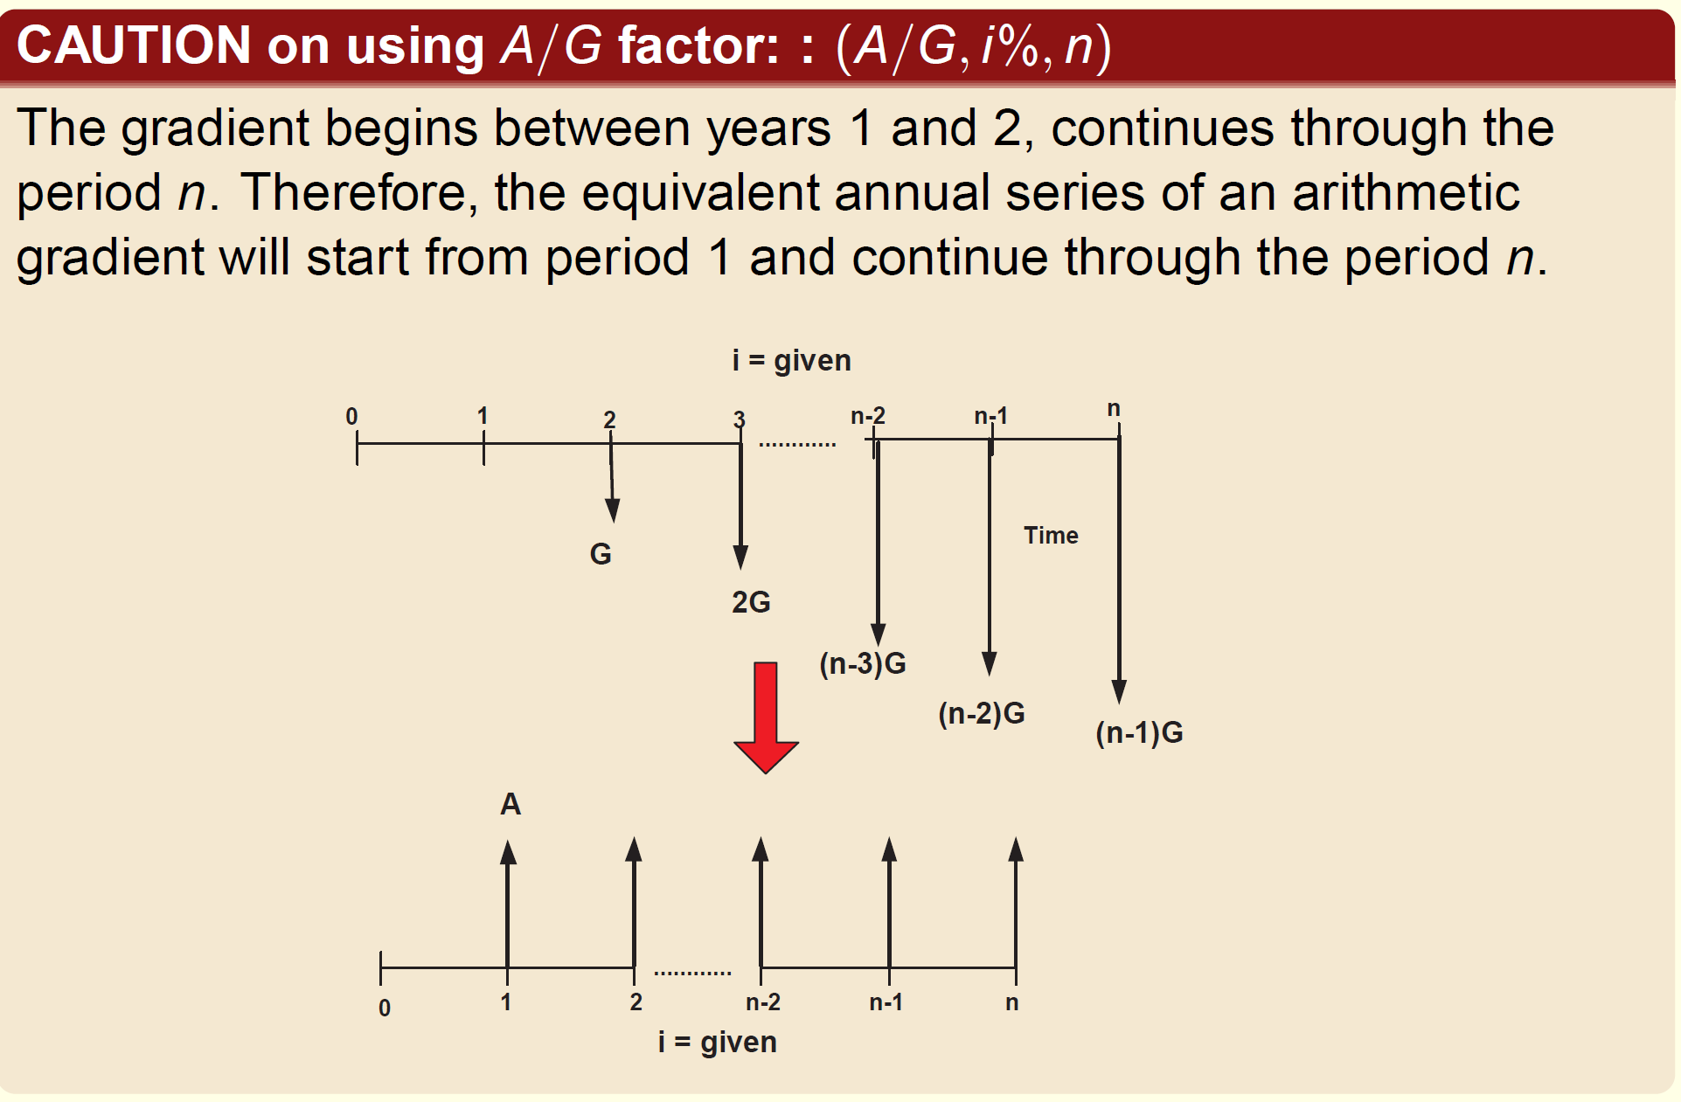

Slide 43
SHIFTED SERIES
Most estimated cash flow series do not fit exactly the series for which the factors are derived so far.
Therefore, we need to combine or shift the given series.
Renumbering the cash flow diagram is a good practice.

Slide 44
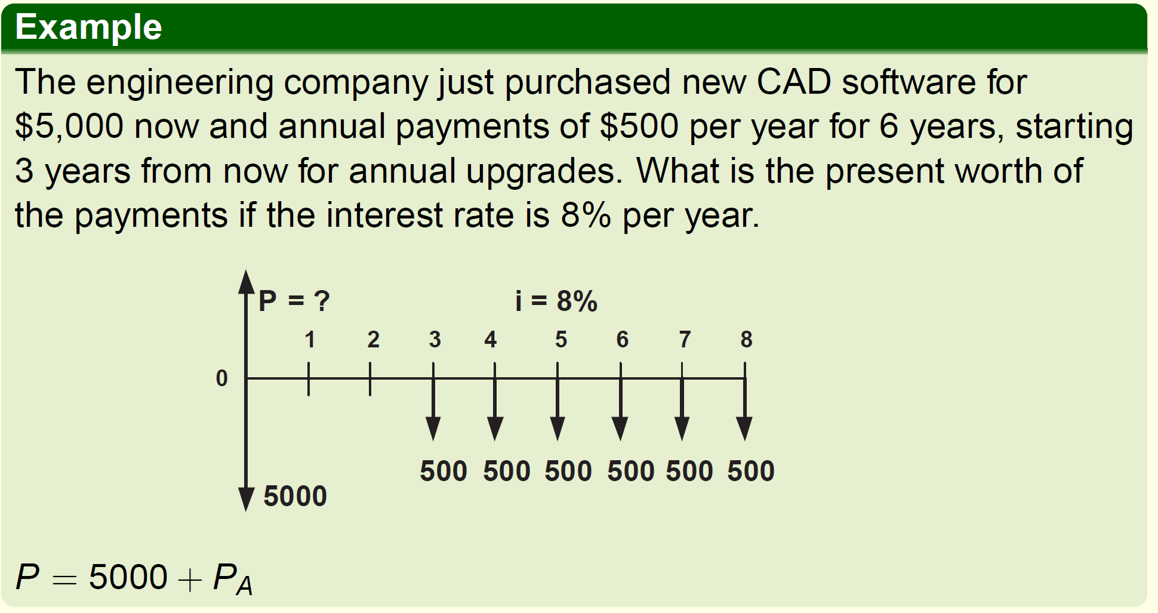

Slide 45
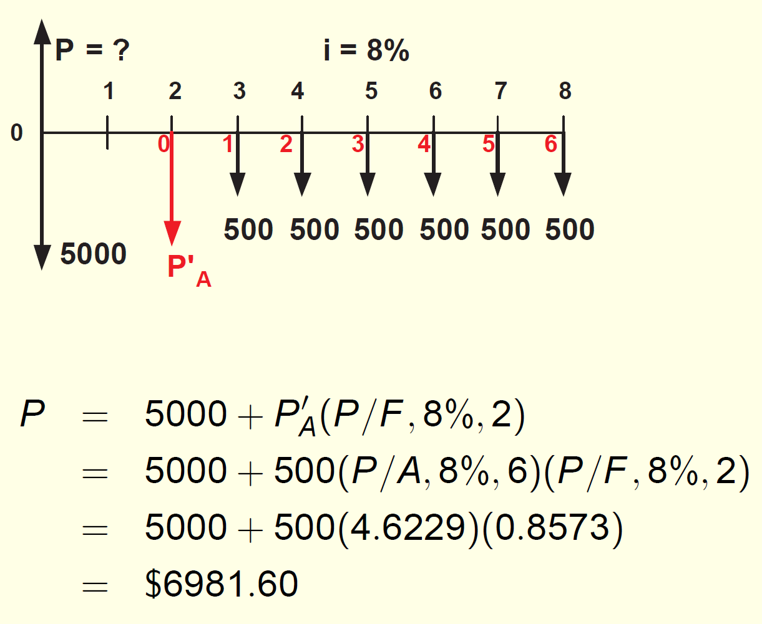

Slide 46
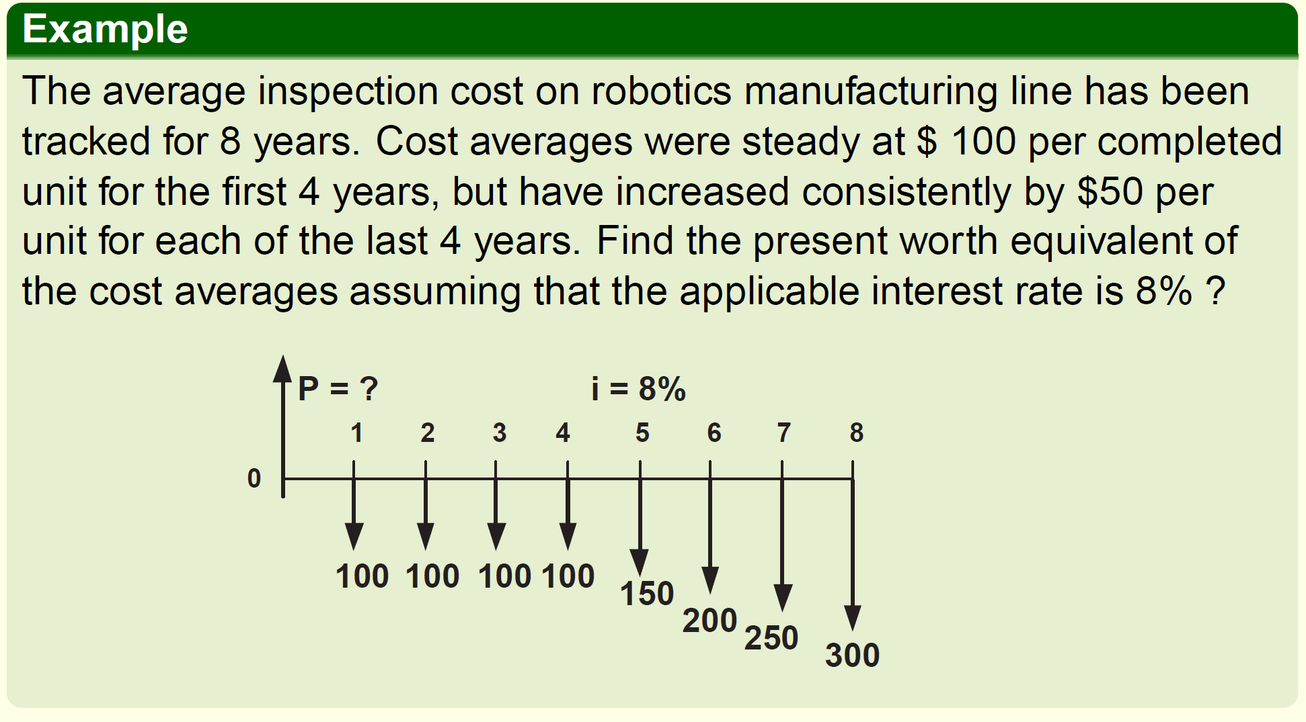

Slide 47
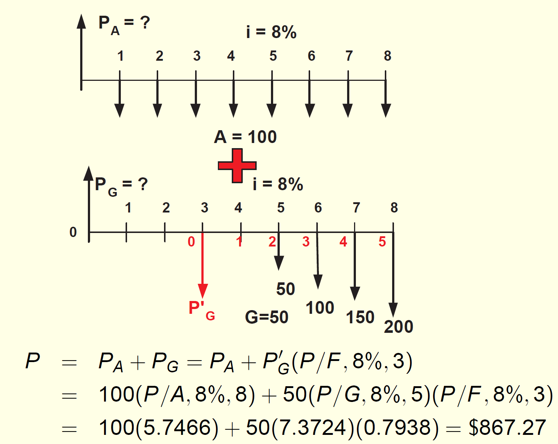

Slide 48
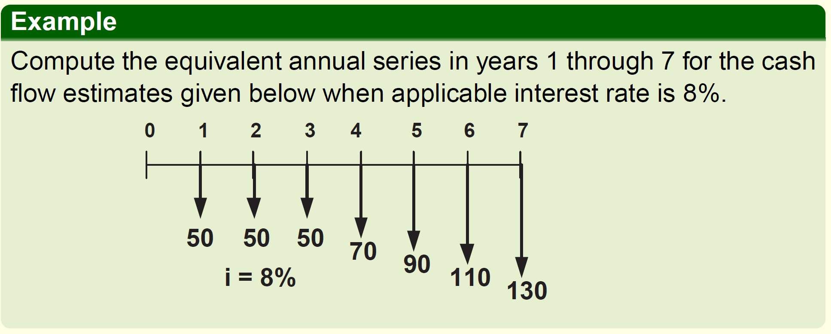

Slide 49
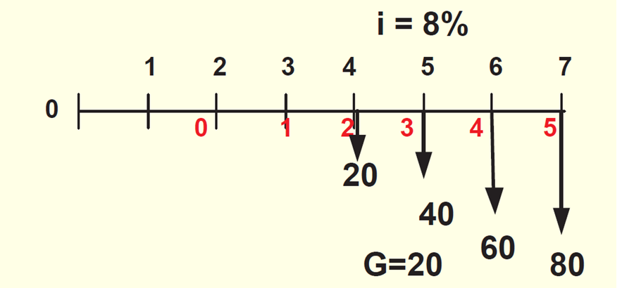

Slide 50
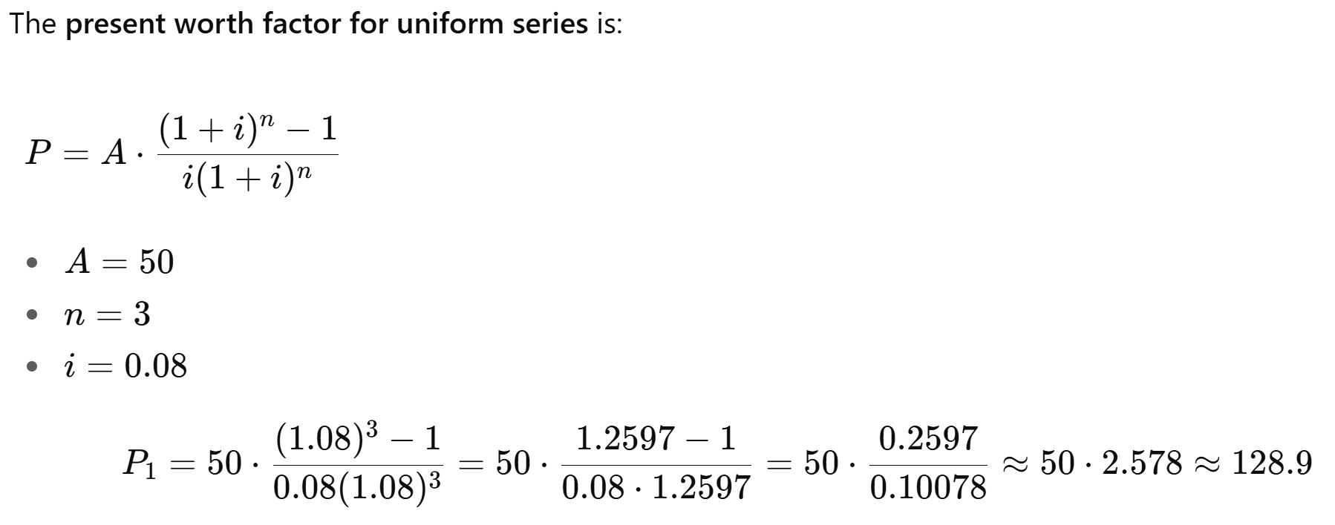

Slide 51
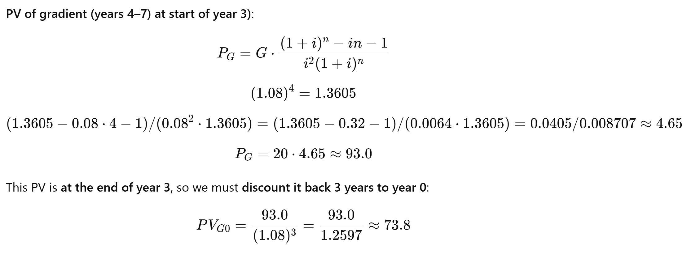
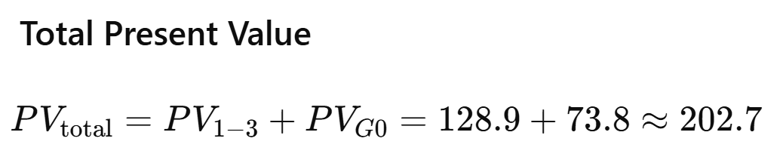

Slide 52
